Slide 1


智冠科技 數位發展中心
Google Cloud Platform Tutorial
智冠科技

Slide 2
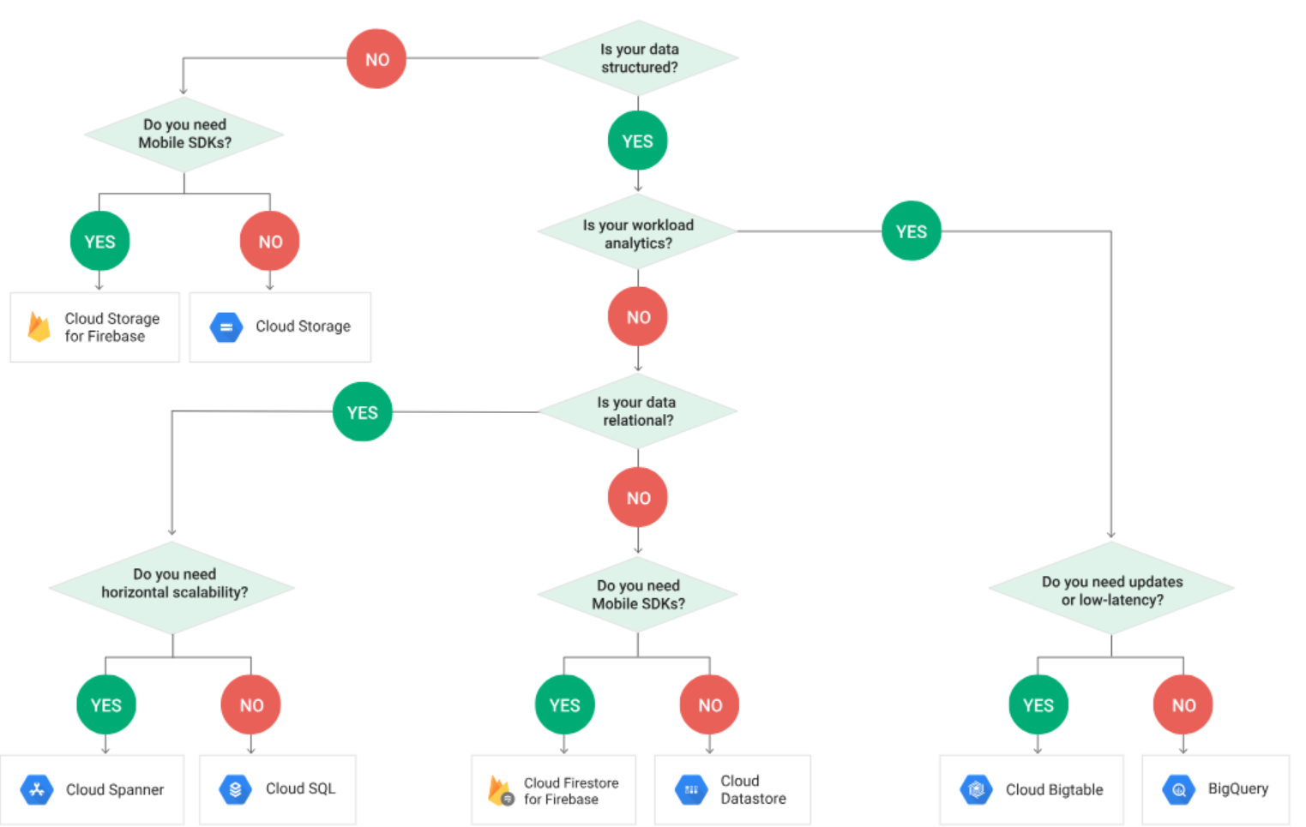

Slide 3

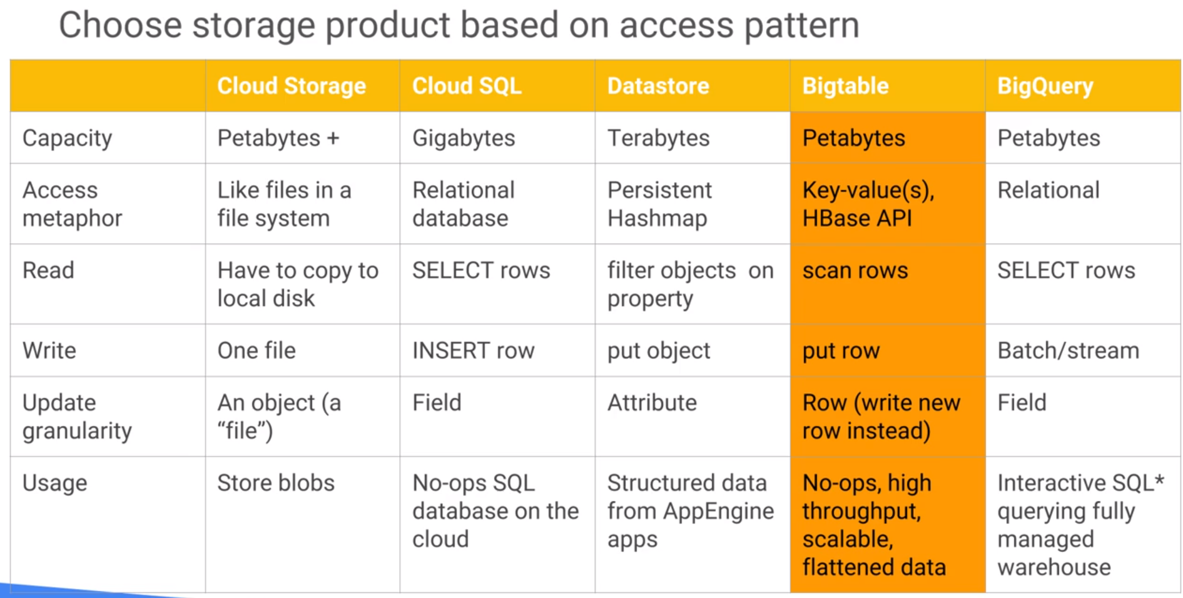
Bigtable, high throughput need, flatten data 1*N
fit time series
cbt

Slide 4
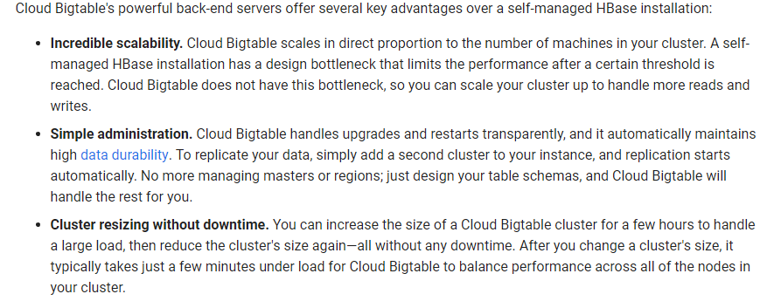
Big Table Document
Big Table
Cluster
N
N
N

Slide 5
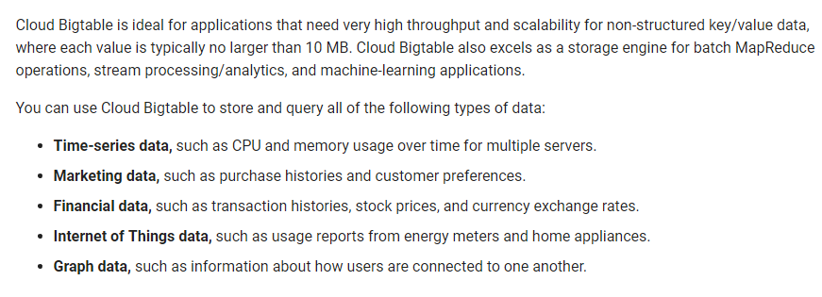
Big Table Document
Big Table

Slide 6
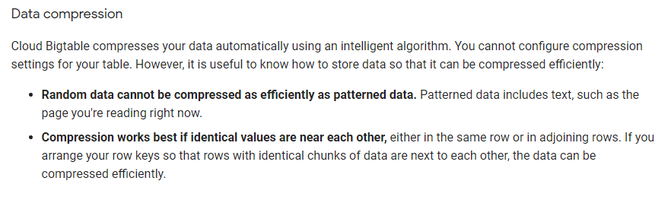
Big Table Document
Big Table

Slide 7
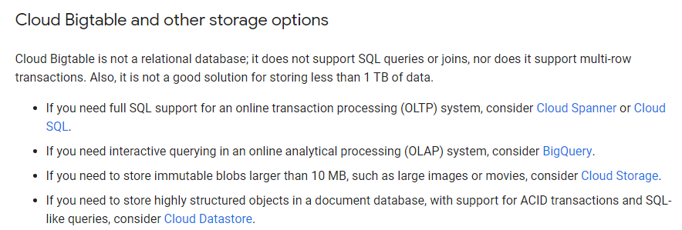
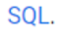
Big Table Document
Big Table

Slide 8
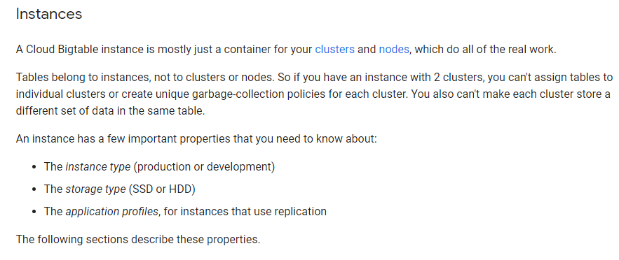
Big Table Document
Big Table

Slide 9
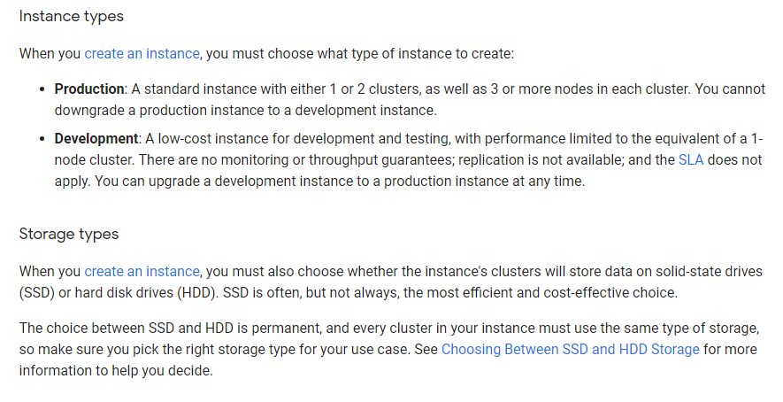
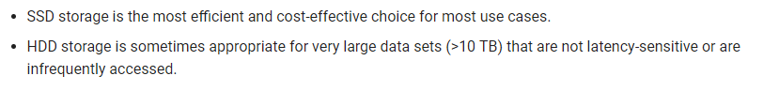
Big Table Document
Big Table
up to 2 clusters in 1 instance
Cluster
N
N
N
Cluster
N

Slide 10
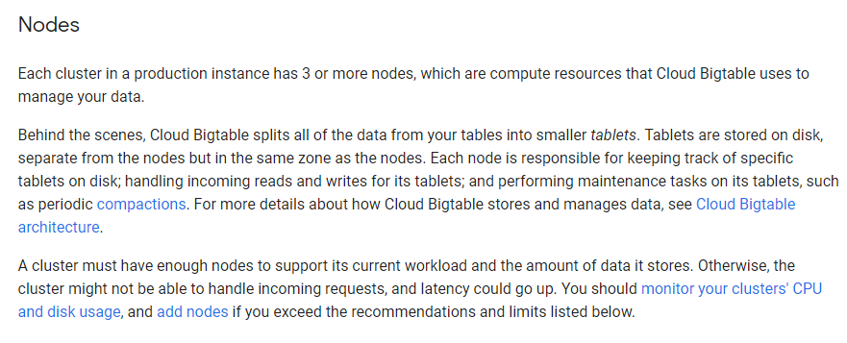
Big Table Document
Big Table
Cluster
N
N
N

Slide 11
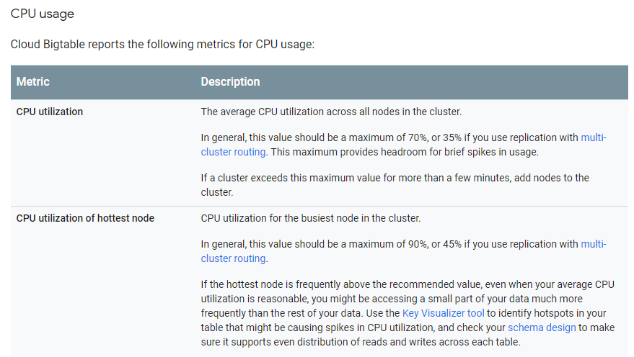
Big Table Document
Big Table

Slide 12
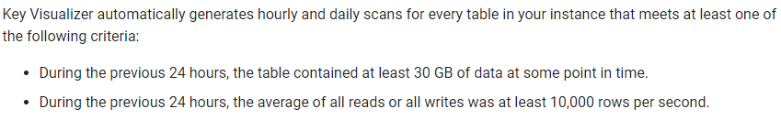
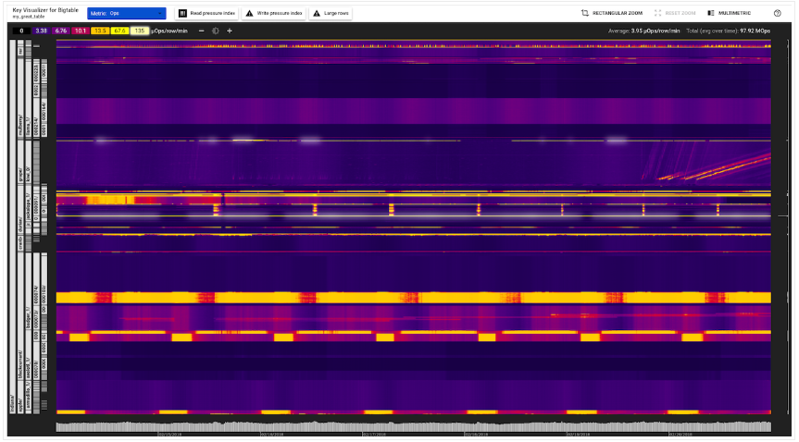
Big Table Document
Big Table

Slide 13
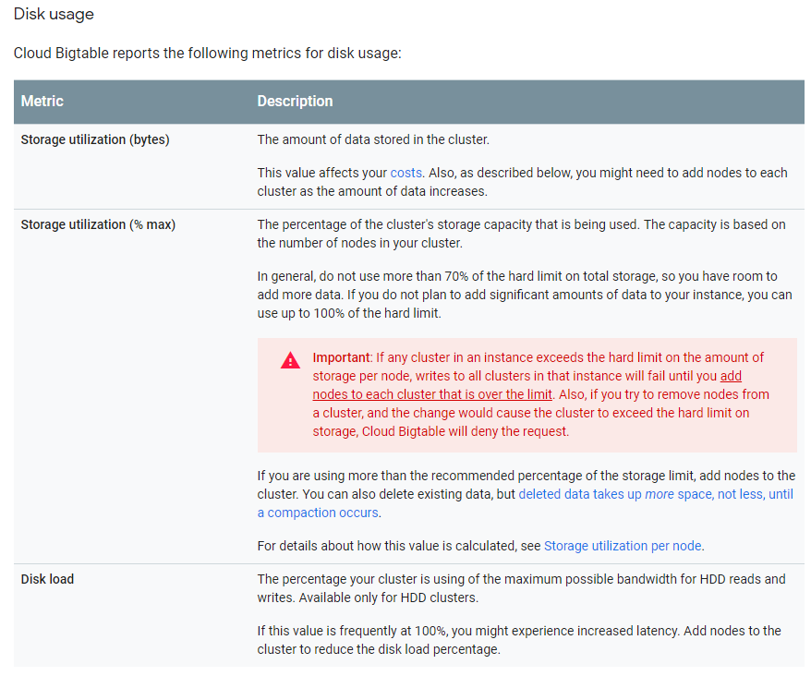
Big Table Document
Big Table

Slide 14
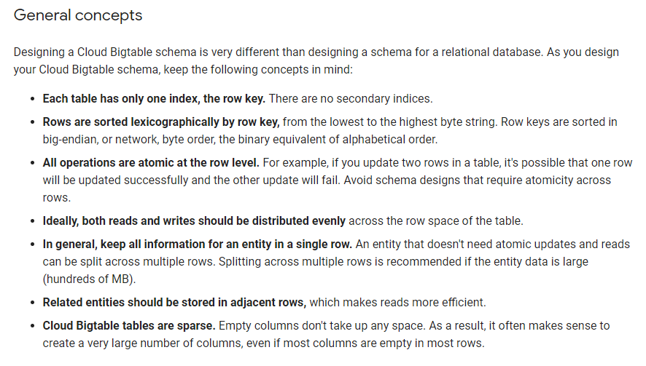
Big Table Document
Big Table
字典順序

Slide 15
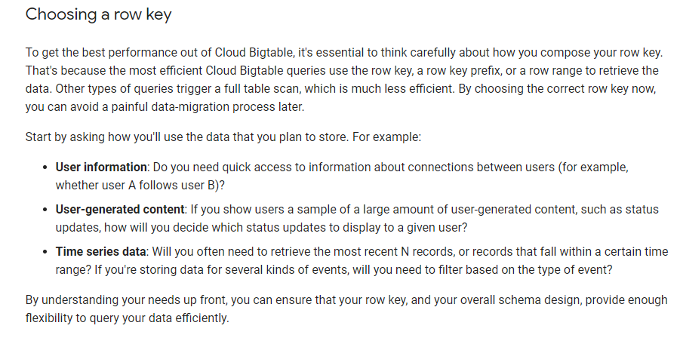
Big Table Document
Big Table

Slide 16
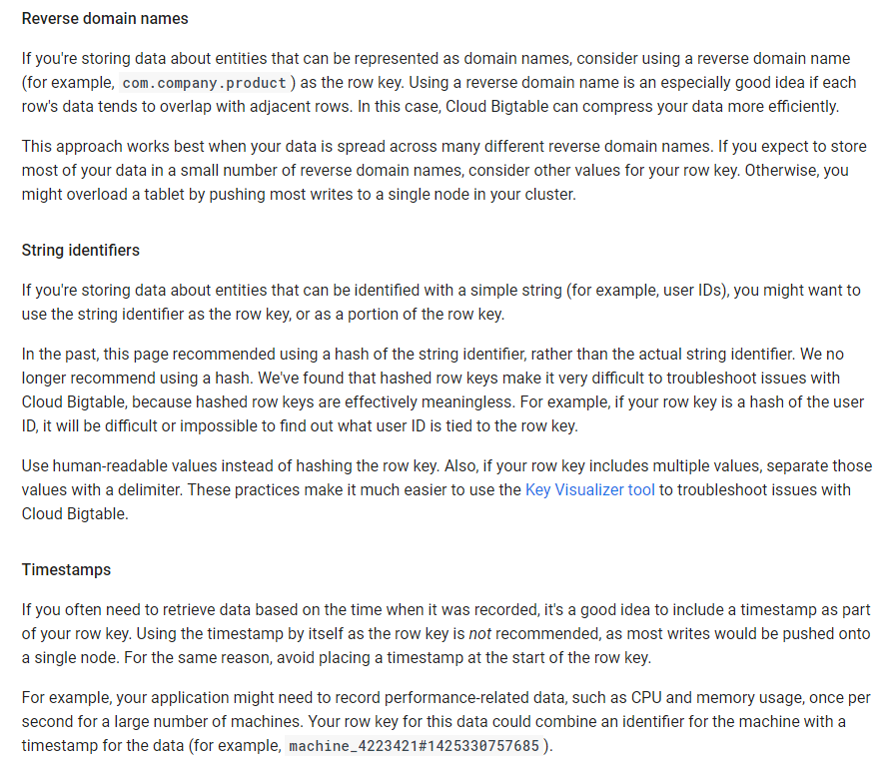
Big Table Document
Big Table

Slide 17
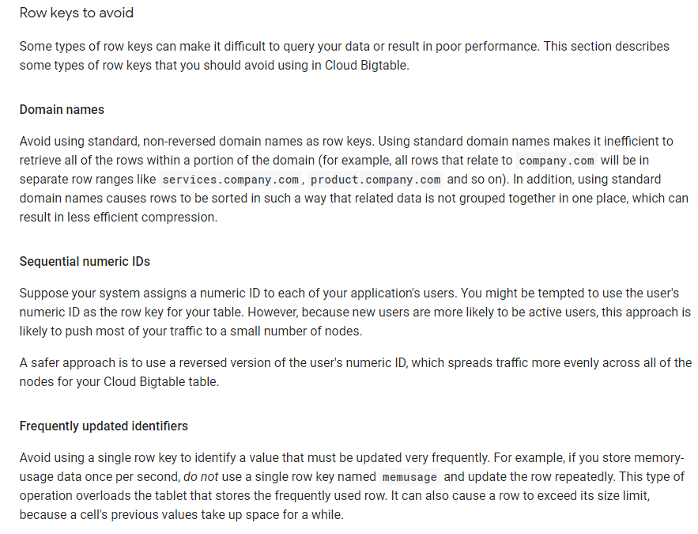
Big Table Document
Big Table

Slide 18
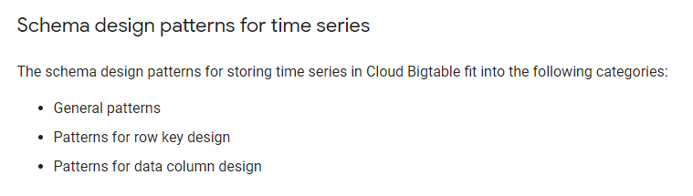
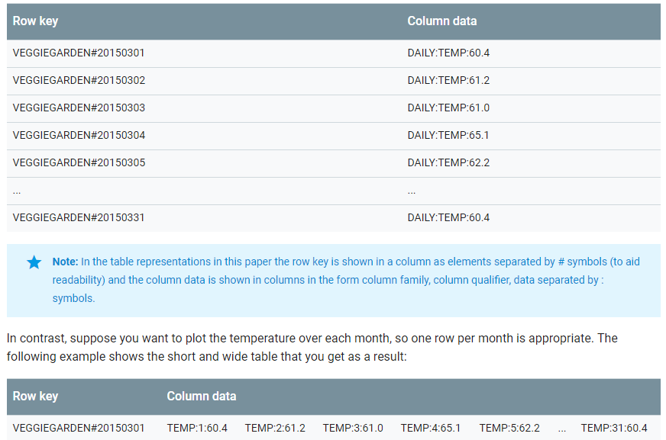
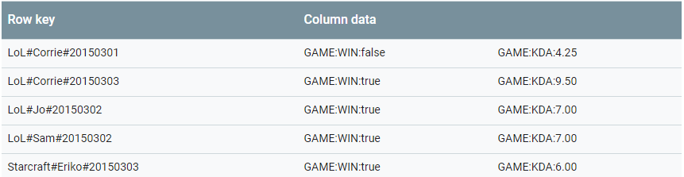
Big Table Document
Big Table

Slide 19
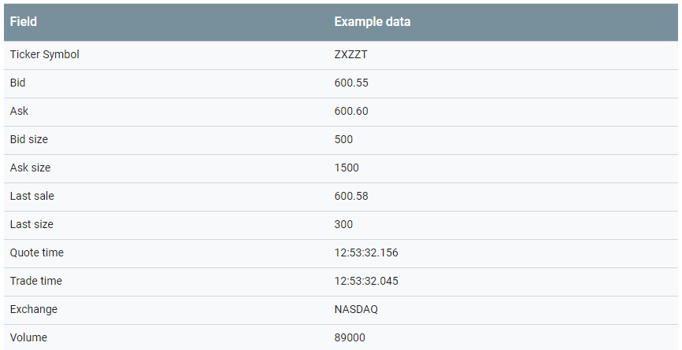
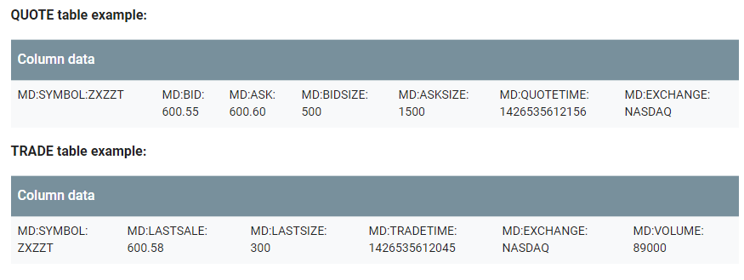
Big Table Document
Big Table

Slide 20
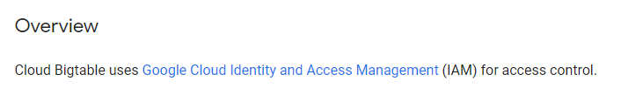
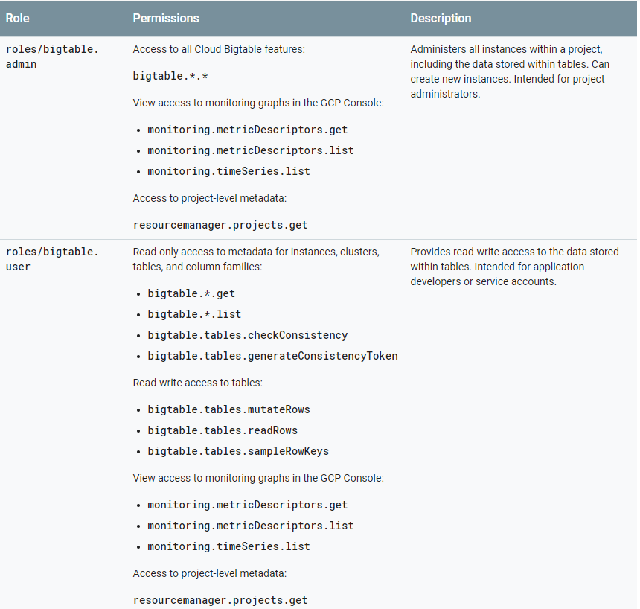
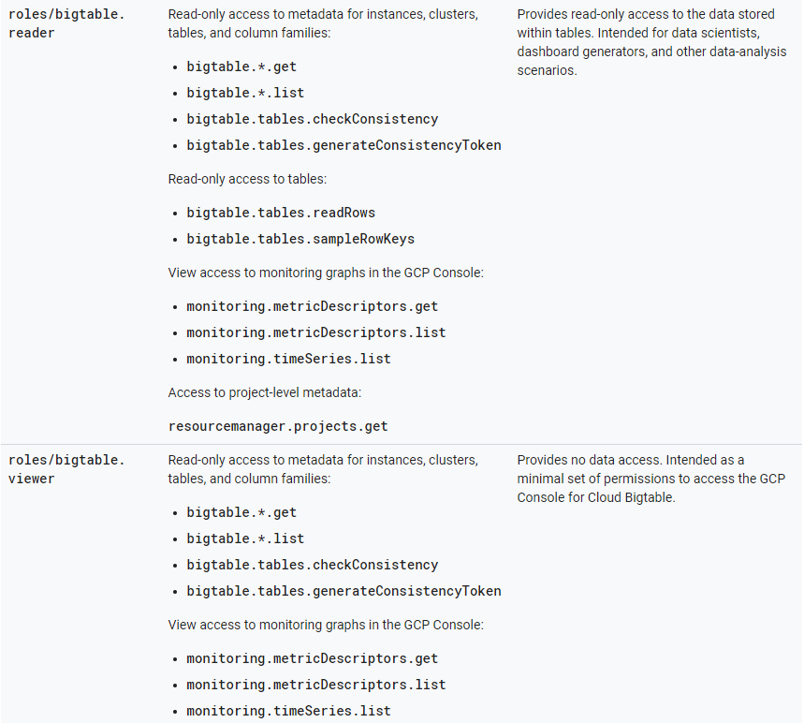
Big Table Document
Big Table

Slide 21
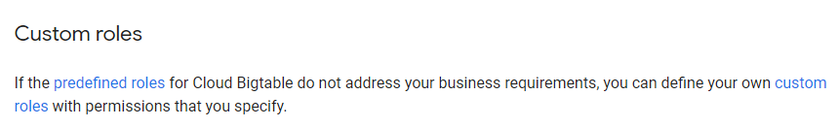
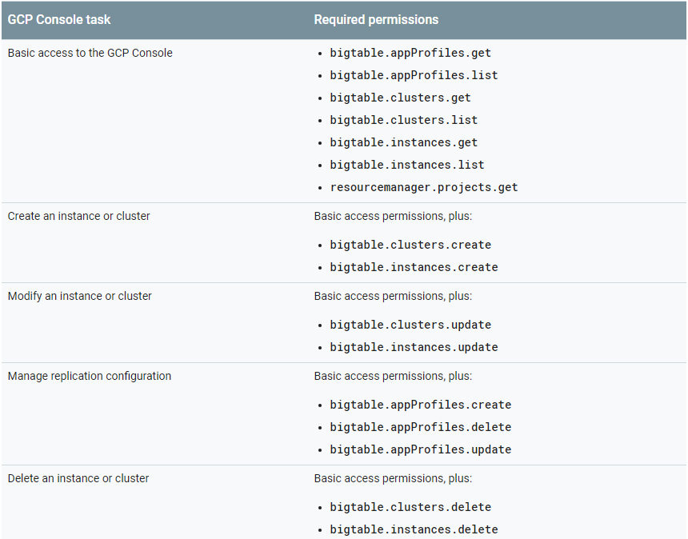
Big Table Document
Big Table

Slide 22
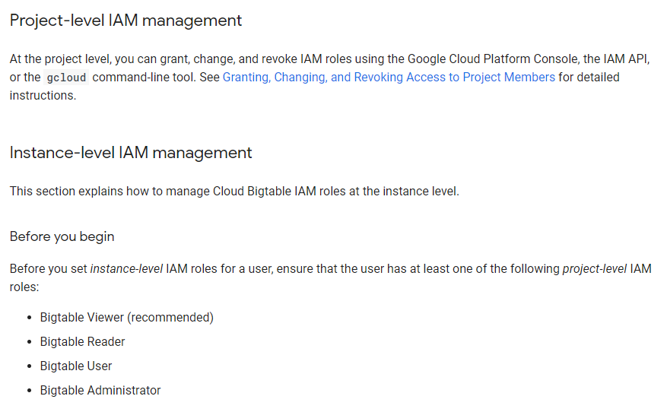
Big Table Document
Big Table

Slide 23
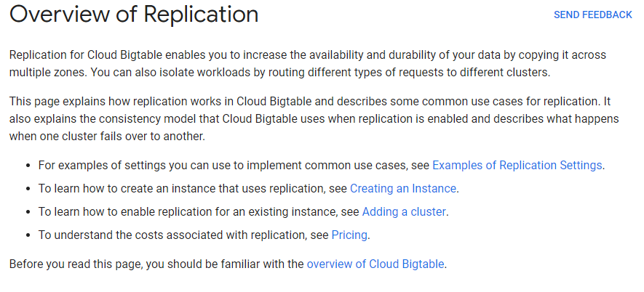
Big Table Document
Big Table

Slide 24
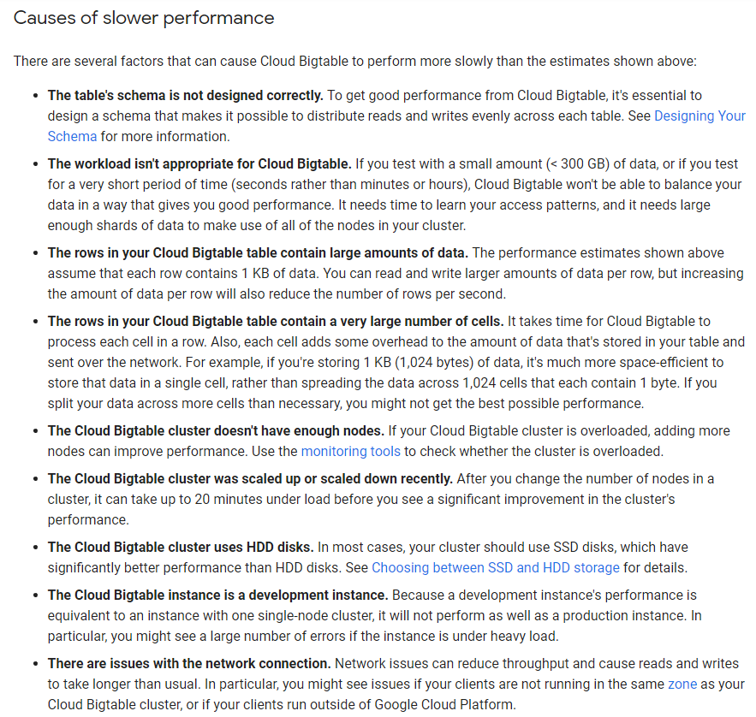
Big Table Document :
Big Table

Slide 25
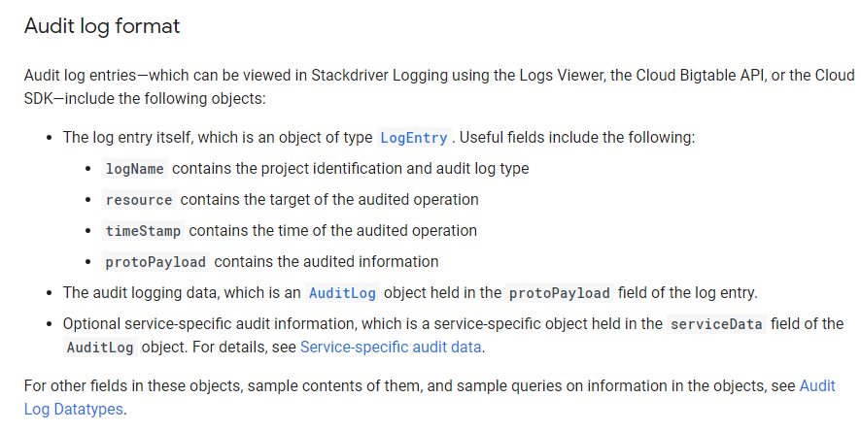
Big Table Document
Big Table

Slide 26
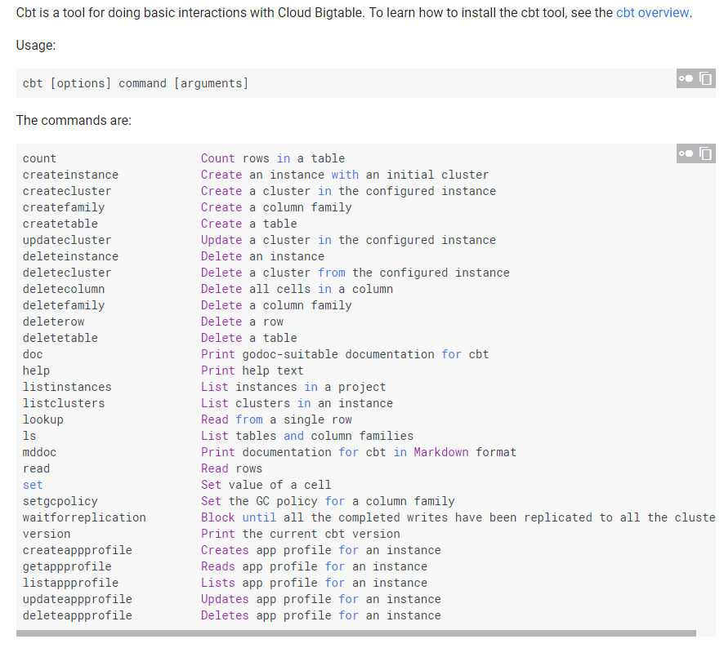
Big Table Document
Big Table

Slide 28

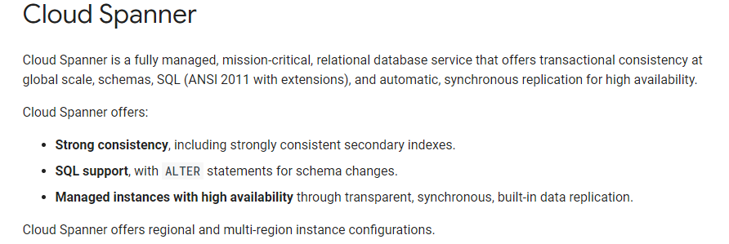
Cloud Spanner
GCP
OLTP

Slide 29
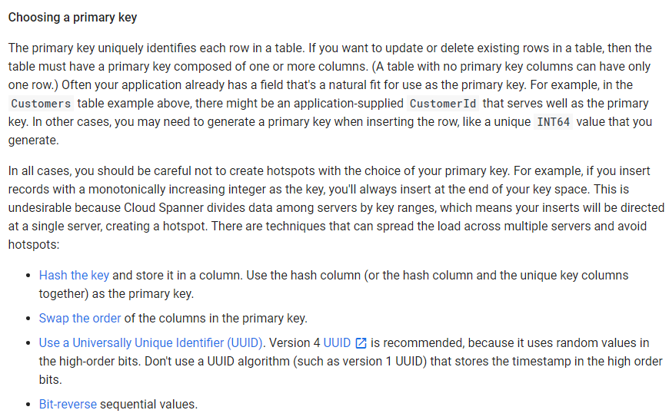
Cloud Spanner
GCP

Slide 30
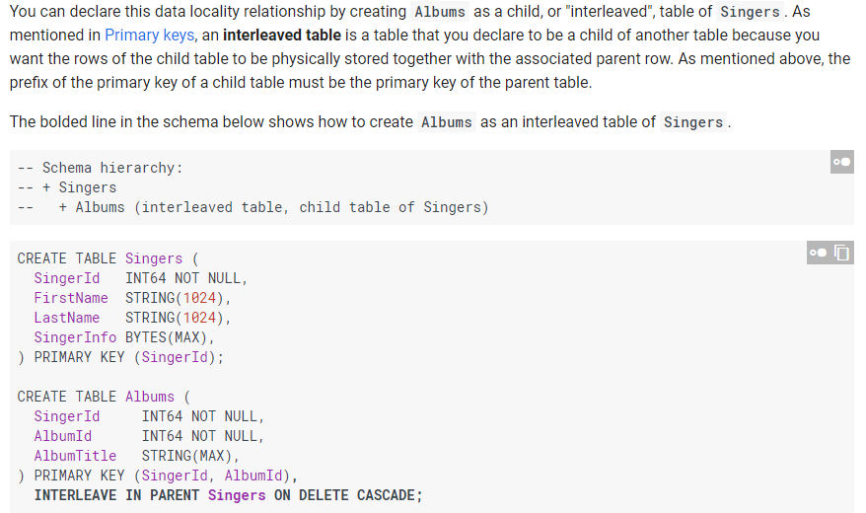
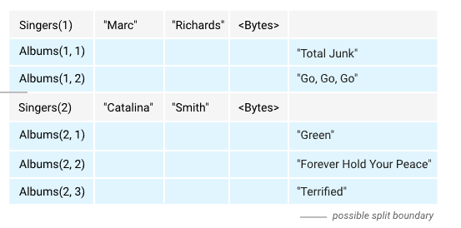
Cloud Spanner
GCP

Slide 31
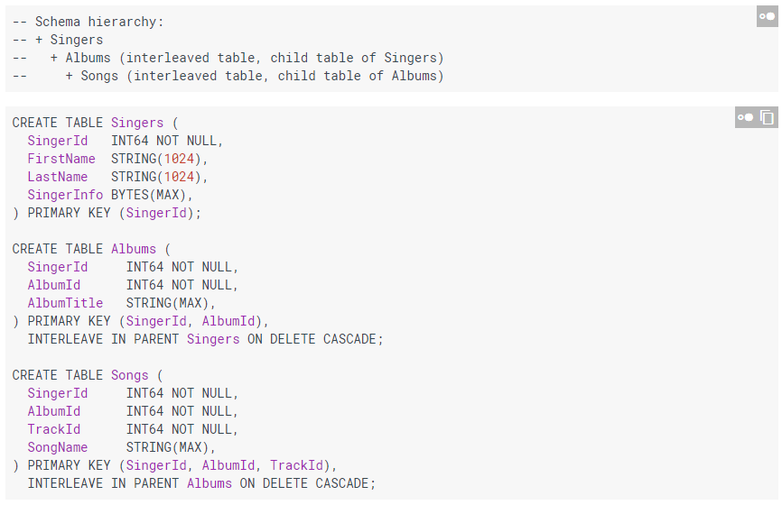
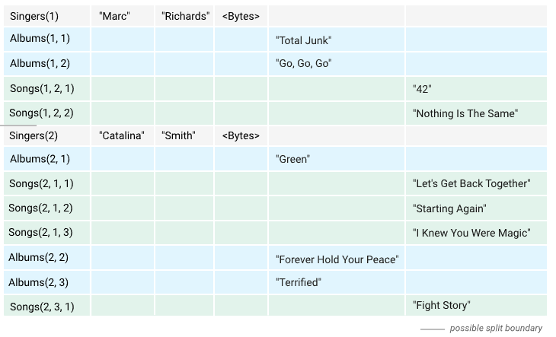
Cloud Spanner
GCP

Slide 32
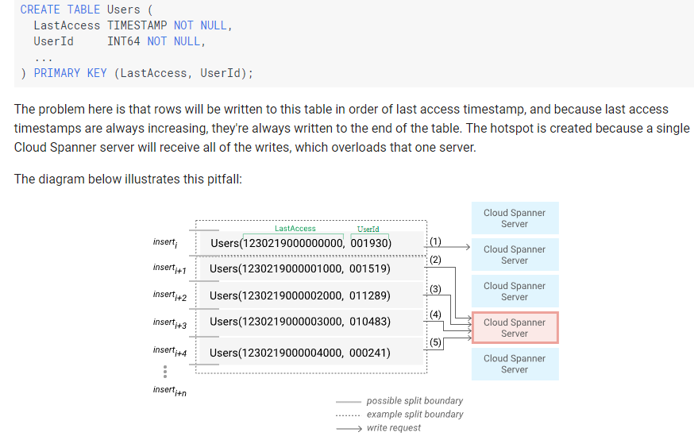
Cloud Spanner
GCP

Slide 33
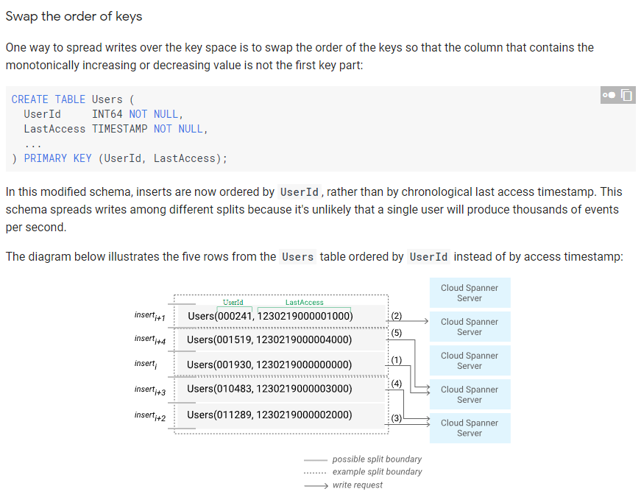
Cloud Spanner
GCP

Slide 34
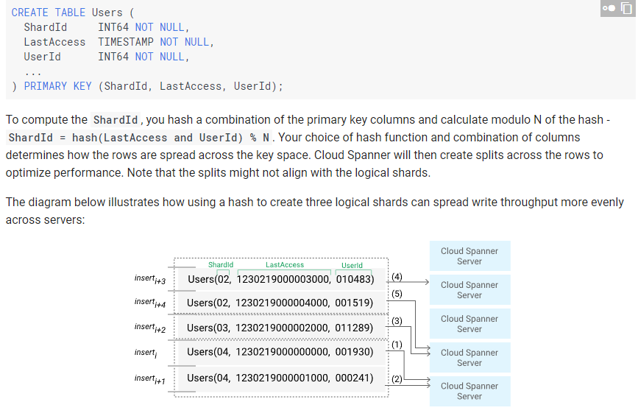
Cloud Spanner
GCP

Slide 35
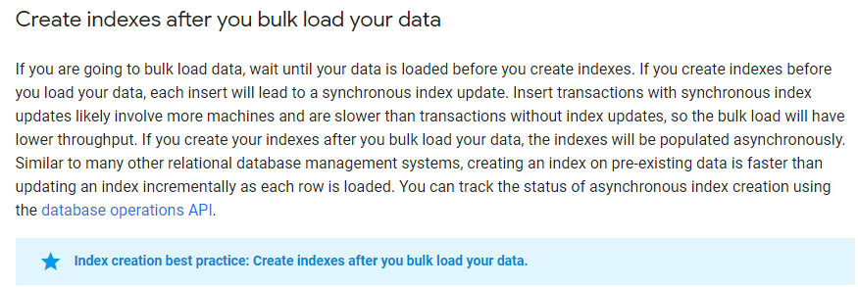
Cloud Spanner
GCP

Slide 36
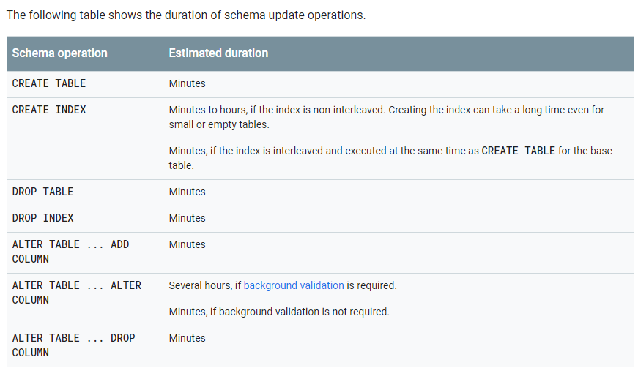
Cloud Spanner
GCP

Slide 37
Cloud Spanner
GCP

Slide 38
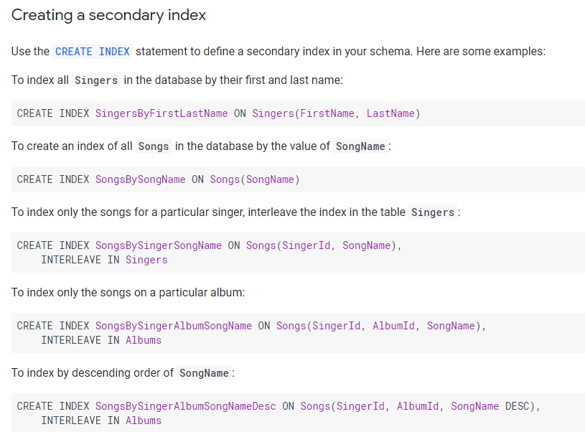
Cloud Spanner
GCP

Slide 39
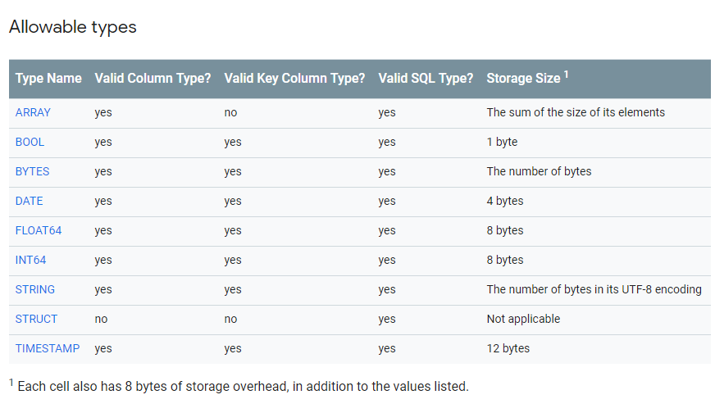
Cloud Spanner
GCP

Slide 40
Cloud Spanner
GCP

Slide 41
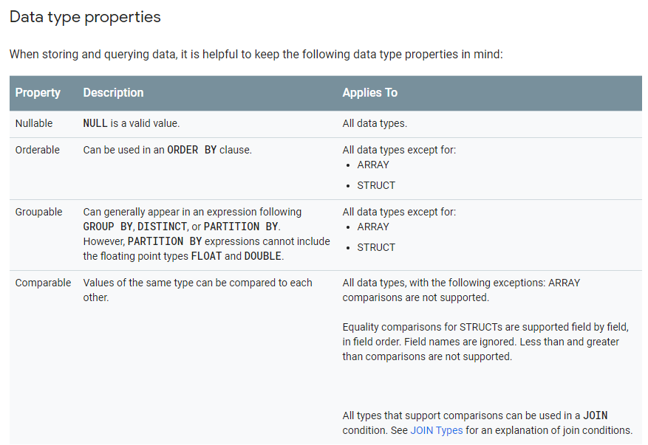
Cloud Spanner
GCP

Slide 42
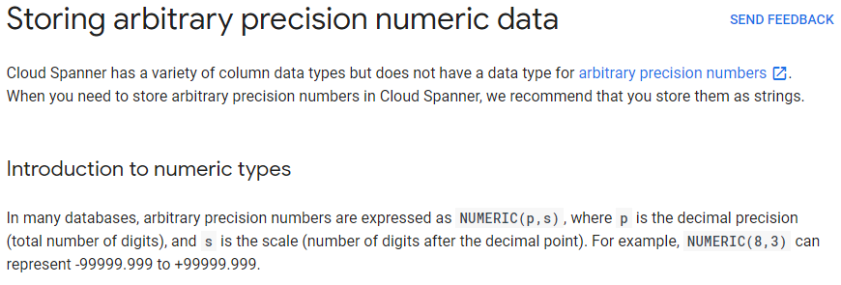
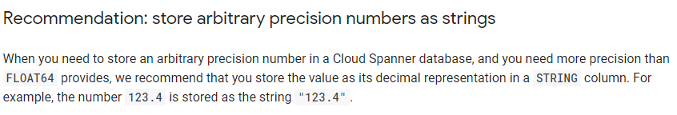
Cloud Spanner
GCP

Slide 43


Cloud Spanner
GCP

Slide 44

Cloud Spanner
GCP

Slide 45

Cloud Spanner
GCP

Slide 46


Cloud Spanner
GCP

Slide 47

Cloud Spanner
GCP

Slide 48

Cloud Spanner
GCP

Slide 49

Cloud Spanner
GCP

Slide 50

Cloud Spanner
GCP

Slide 51

Cloud Spanner
GCP

Slide 52


Cloud Spanner
GCP

Slide 53

Cloud Spanner
GCP

Slide 54

Cloud Spanner
GCP

Slide 55
Cloud Spanner
GCP

Slide 56

Cloud Spanner
GCP

Slide 57

Cloud Spanner
GCP

Slide 58

Cloud Spanner
GCP

Slide 59

Cloud Spanner
GCP

Slide 60

Cloud Spanner
GCP

Slide 61


Cloud Spanner
GCP

Slide 62

Cloud Spanner
GCP

Slide 64


GCP, Step 2, Choose One Solution to Store Data: Cloud SQL, RDB for gigabytes

Slide 65

GCP, Step 2, Choose One Solution to Store Data: Cloud SQL , RDB for gigabytes
Cons：
Use RDB schema to show OO Data, Hierarchical, NULL is needed to fill in the column which leads to data integrity problems

Slide 66

Cloud SQL
GCP

Slide 67

Cloud SQL
GCP

Slide 68

Cloud SQL
GCP

Slide 69

Cloud SQL
GCP

Slide 70

Cloud SQL
GCP

Slide 71

Cloud SQL
GCP

Slide 72

Cloud SQL
GCP

Slide 73
Cloud SQL
GCP

Slide 74

Cloud SQL
GCP

Slide 76

GCP, Step 2, Choose One Solution to Store Data: BigQuery, Datawarehouse solution

Slide 77

BigQuery
GCP

Slide 78

BigQuery
GCP

Slide 79

BigQuery
GCP

Slide 80
BigQuery
GCP

Slide 81

BigQuery
GCP

Slide 82

BigQuery
GCP

Slide 83

BigQuery
GCP

Slide 84

BigQuery
GCP

Slide 85


BigQuery
GCP

Slide 86

BigQuery
GCP

Slide 87


BigQuery
GCP

Slide 88

BigQuery
GCP

Slide 89

BigQuery
GCP

Slide 90



BigQuery
GCP

Slide 91


BigQuery
GCP

Slide 92

BigQuery
GCP

Slide 93

BigQuery
GCP

Slide 94

BigQuery
GCP

Slide 95


BigQuery
GCP

Slide 96


BigQuery
GCP

Slide 97




BigQuery
GCP

Slide 98

BigQuery
GCP

Slide 99

BigQuery
GCP

Slide 100

BigQuery
GCP

Slide 101

BigQuery
GCP

Slide 102

BigQuery
GCP

Slide 103

BigQuery
GCP

Slide 104

BigQuery
GCP

Slide 105

BigQuery
GCP
Currently Cloud Storage and local data only

Slide 106

BigQuery
GCP
Key Management System

Slide 107

BigQuery
GCP

Slide 108

BigQuery
GCP

Slide 109

BigQuery
GCP

Slide 110

BigQuery
GCP

Slide 112


GCP, Step 2, Choose One Solution to Store Data: DataStore, transaction support for Hierarchy data

Slide 113

GCP, Step 2, Choose One Solution to Store Data: DataStore, transaction support for Hierarchy data
Attributes

Slide 114

GCP, Step 2, Choose One Solution to Store Data: DataStore, transaction support for Hierarchy data
Memory
Cloud: save it to xx entity
Iterable, since selected data (gigabyte) might too big to save into memory
objectify

Slide 115

DataStore
GCP

Slide 116

DataStore (Cloud FireStore)
GCP

Slide 117

DataStore (Cloud FireStore)
GCP

Slide 118


DataStore (Cloud FireStore)
GCP

Slide 119

DataStore (Cloud FireStore)
GCP

Slide 120


DataStore (Cloud FireStore)
GCP

Slide 121

DataStore (Cloud FireStore)
GCP

Slide 122



DataStore (Cloud FireStore)
GCP

Slide 123


DataStore (Cloud FireStore)
GCP

Slide 124

DataStore (Cloud FireStore)
GCP

Slide 125

DataStore (Cloud FireStore)
GCP

Slide 126

DataStore (Cloud FireStore)
GCP

Slide 127

DataStore (Cloud FireStore)
GCP

Slide 128

DataStore (Cloud FireStore)
GCP

Slide 129

DataStore (Cloud FireStore)
GCP

Slide 130

DataStore (Cloud FireStore)
GCP

Slide 131

DataStore (Cloud FireStore)
GCP

Slide 132

DataStore (Cloud FireStore)
GCP

Slide 133
DataStore (Cloud FireStore)
GCP

Slide 134


DataStore (Cloud FireStore)
GCP

Slide 135

DataStore (Cloud FireStore)
GCP

Slide 136

DataStore (Cloud FireStore)
GCP

Slide 137
DataStore (Cloud FireStore)
GCP

Slide 138

DataStore (Cloud FireStore)
GCP

Slide 139

DataStore (Cloud FireStore)
GCP

Slide 140

DataStore (Cloud FireStore)
GCP

Slide 141

DataStore (Cloud FireStore)
GCP

Slide 142


DataStore (Cloud FireStore)
GCP

Slide 143

DataStore (Cloud FireStore)
GCP

Slide 144

DataStore (Cloud FireStore)
GCP

Slide 145

DataStore (Cloud FireStore)
GCP

Slide 146

DataStore (Cloud FireStore)
GCP

Slide 147

DataStore (Cloud FireStore)
GCP

Slide 148

DataStore (Cloud FireStore)
GCP

Slide 149

DataStore (Cloud FireStore)
GCP

Slide 150


DataStore (Cloud FireStore)
GCP

Slide 151

DataStore (Cloud FireStore)
GCP

Slide 152


DataStore (Cloud FireStore)
GCP

Slide 153

DataStore (Cloud FireStore)
GCP

Slide 154

DataStore (Cloud FireStore)
GCP

Slide 155

DataStore (Cloud FireStore)
GCP

Slide 156

DataStore (Cloud FireStore)
GCP

Slide 157

DataStore (Cloud FireStore)
GCP

Slide 158

DataStore (Cloud FireStore)
GCP

Slide 159

DataStore (Cloud FireStore)
GCP

Slide 160

DataStore (Cloud FireStore)
GCP

Slide 161

DataStore (Cloud FireStore)
GCP

Slide 162

DataStore (Cloud FireStore)
GCP

Slide 163

DataStore (Cloud FireStore)
GCP

Slide 164

DataStore (Cloud FireStore)
GCP

Slide 165

DataStore (Cloud FireStore)
GCP

Slide 166

DataStore (Cloud FireStore)
GCP
Encrypts and decrypted automatically

Slide 167


DataStore (Cloud FireStore)
GCP

Slide 168

DataStore (Cloud FireStore)
GCP

Slide 169

DataStore (Cloud FireStore)
GCP

Slide 170

DataStore (Cloud FireStore)
GCP

Slide 171

DataStore (Cloud FireStore)
GCP

Slide 172

DataStore (Cloud FireStore)
GCP

Slide 173

DataStore (Cloud FireStore)
GCP

Slide 174




DataStore (Cloud FireStore)
GCP

Slide 175


DataStore (Cloud FireStore)
GCP

